Slide 1
Creating a Risk Assessment Template.
PLEASE NOTE ANY CHANGES TO WORDING, GHOST TEXT, ORDER OF QUESTIONS ETC SHOULD BE MIRRORED IN THE ACTUAL RISK ASSESSMENT PROCESS AND PREVIEWS

Slide 2
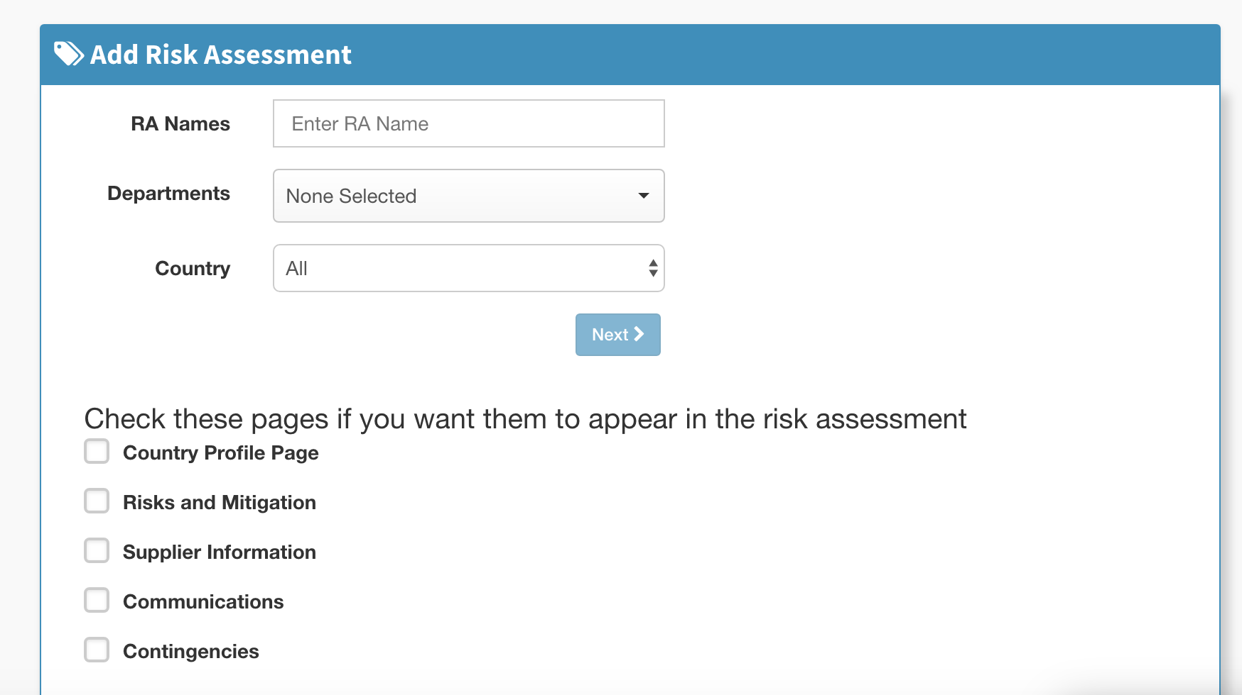
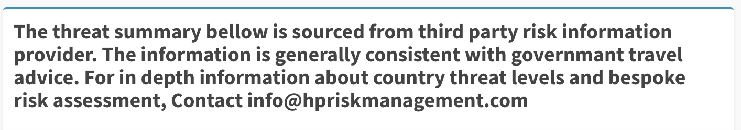
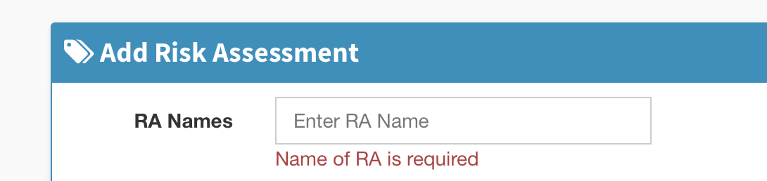
Change field name (RA Names) and ghost text (Enter RA Name) to Template Name. (DONE)
When not populated, change red text to Template Name required (DONE)
Change ‘bellow’ to below. Change ‘governmant’ to government. Change Contact to contact

Slide 3
1.) change text to Select the sections that you want to appear in the risk assessment
2.) Add one addition space/line break between this sentence and Country Profile Page

Slide 4
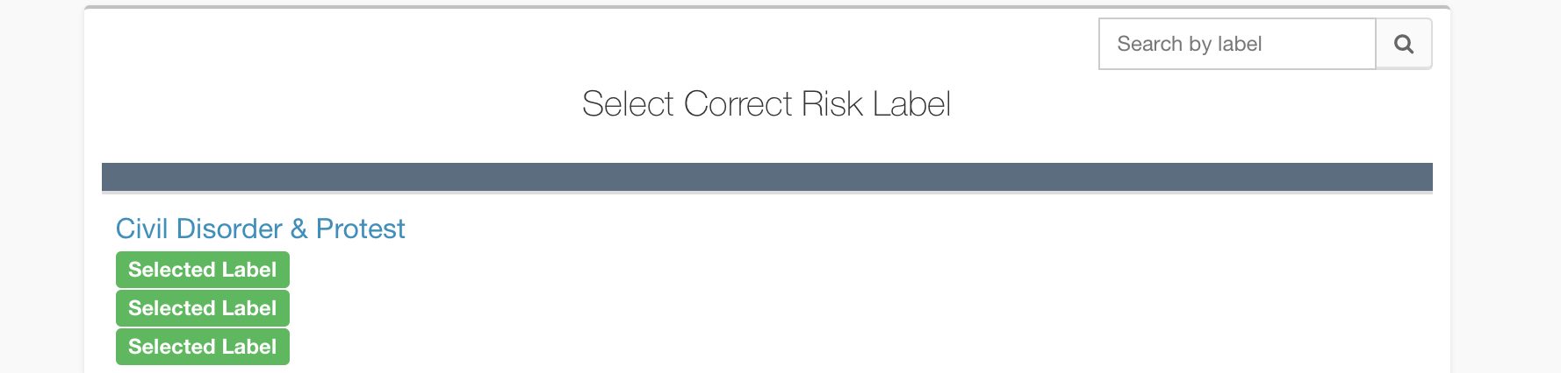
change to Search
2) change to Select Risk Labels

Slide 5
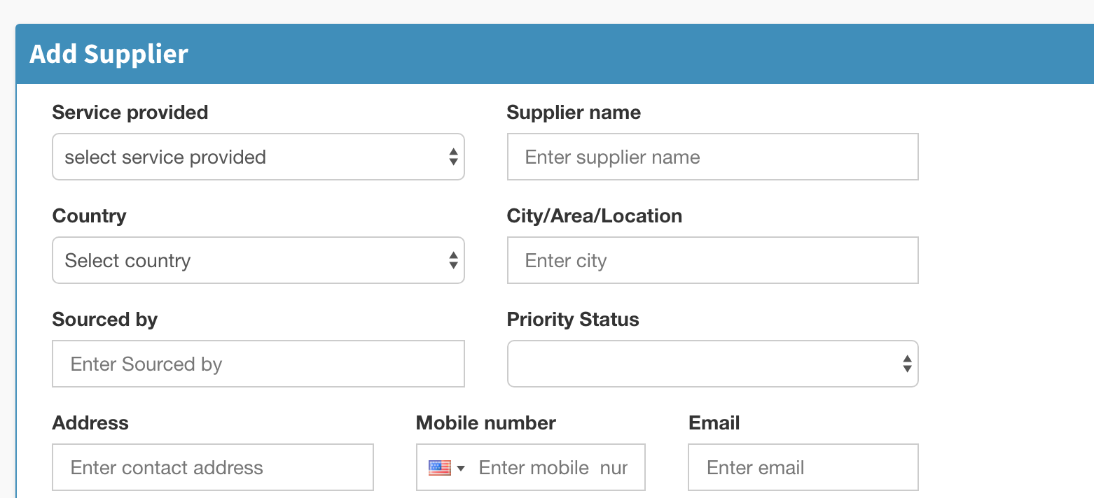
Breadcrumb 4: for each field.
Capitalisation needed on first letter of words in bold: Change Service provided to Service Provided. Change Supplier name to Supplier Name. Change Sourced by to Sourced By. Change Mobile number to Mobile Number.
Make the ghost text match the field title (remove “select” and “Enter”)

Slide 6
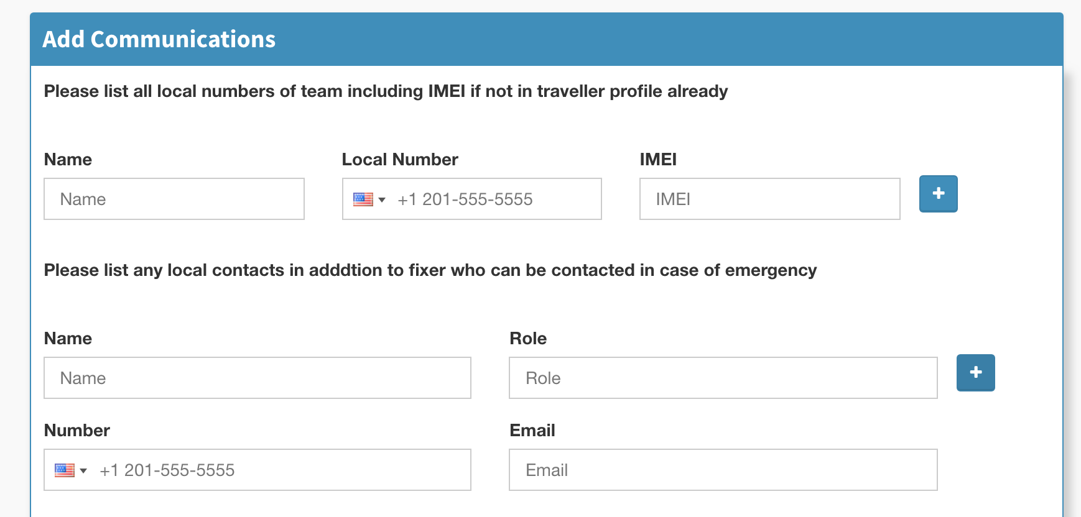
Breadcrumb 5.
change top field text to ‘List additional local numbers’
Both the ghost text numbers should not show as its misleading to user
change bottom question to ‘List any additional local emergency contacts’

Slide 7
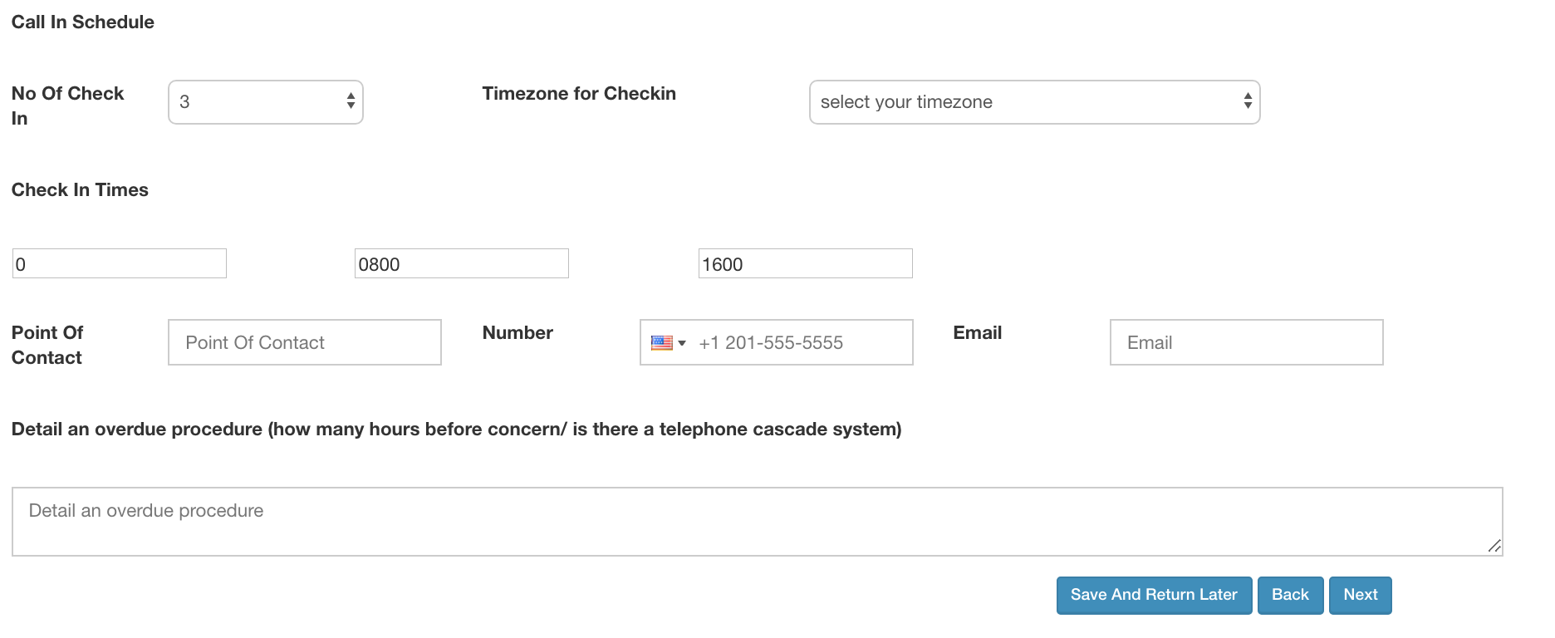
Breadcrumb 5 1.) Change Call in schedule to Check-in Schedule
2.) Add full stop after ‘No’, like this: No. of Check-ins 3.) Change Timezone for Checkin to: Time Zone for Check-in 4.) Change ghost text on select your timezone to Select Your Time Zone
5.) Remove phone number from ghost text 6.) Change Detail an overdue procedure field text to: Overdue procedure (minutes/hours before concern; telephone cascade plan) REMOVE THE WORD SYSTEM 7.) Change ghost text for this to: Overdue procedure

Slide 8
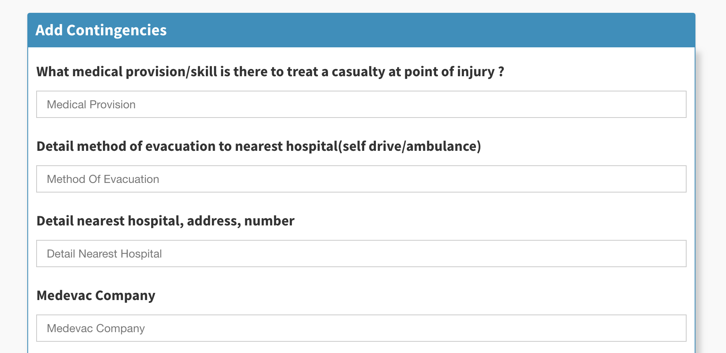
Breadcrumb 6. in descending order:
1) remove space before question mark. 2) change text to Method of evacuation to nearest hospital (self drive/ambulance etc). (Add space before bracket). 3) Method of evacuation (capitalisation) 4) change text to: Local hospital information 5) change text to: Medical Evacuation Company. 6.) Change order of questions
can you change the order of these two questions both here and in the risk assessment process? Change should also be reflected in preview and PDF
Notes:
Ask tom about breadcrumb 3

Slide 9
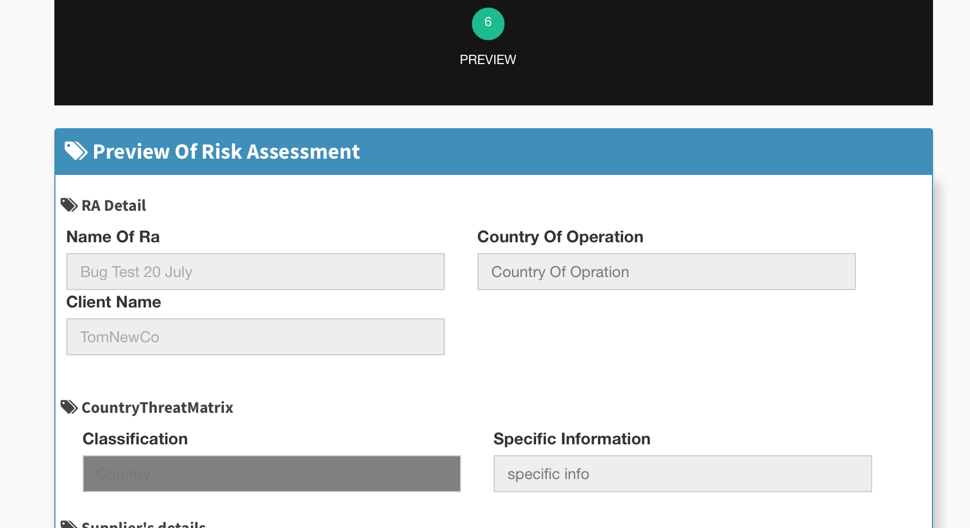
Breadcrumb 6) Preview.
As a minimum, change typo on Opration in the Country of Operation box.
2.) Specific Information box should be removed.

Slide 10
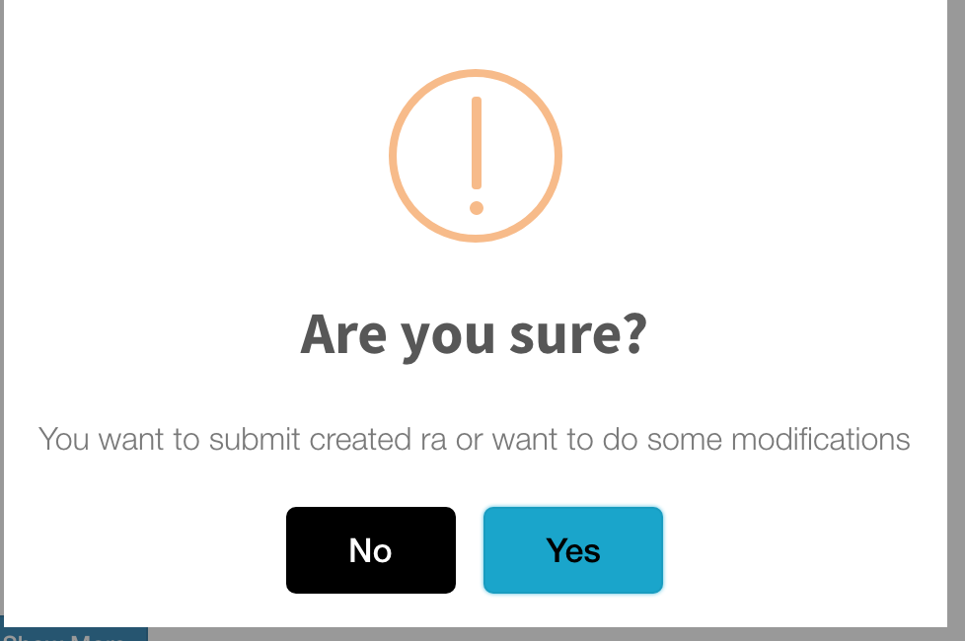
Change text to
Submit? (replacing Are you sure?)
Confirm submission of risk assessment (replacing smaller text)

Slide 11
Completing a risk assessment
NOTE. This does not include all the changes requested in the Create Template Process, many which should carry across

Slide 12
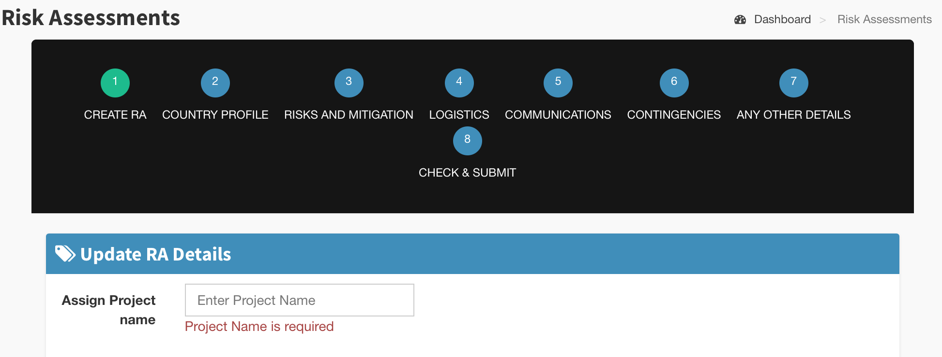
Breadcrumb 1 -
1.)Text and ghost text are different. Change both to Project Name

Slide 13
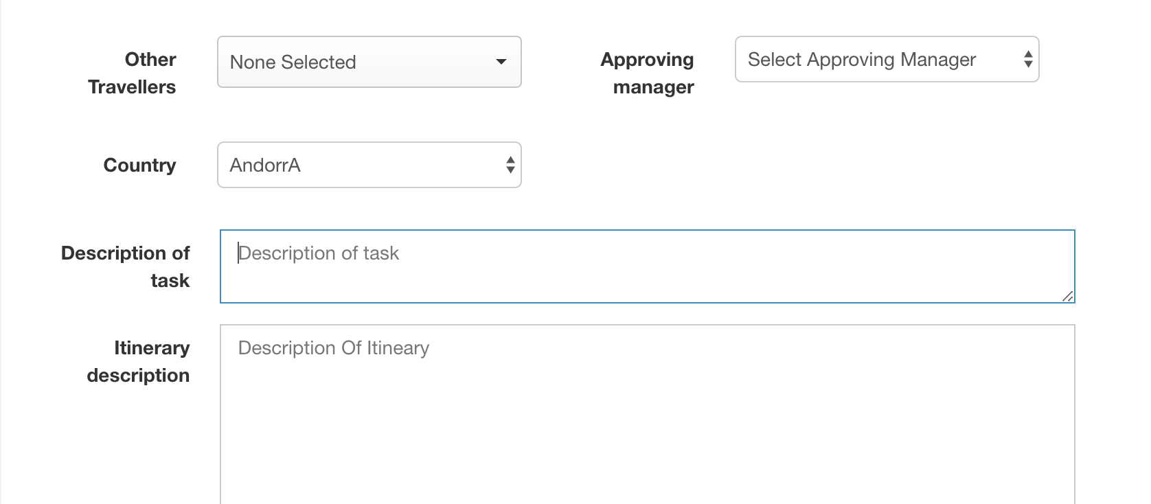
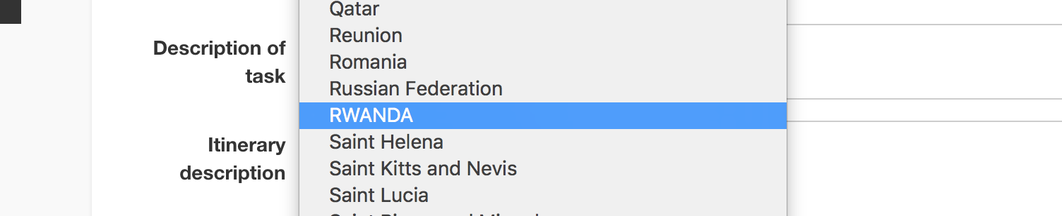
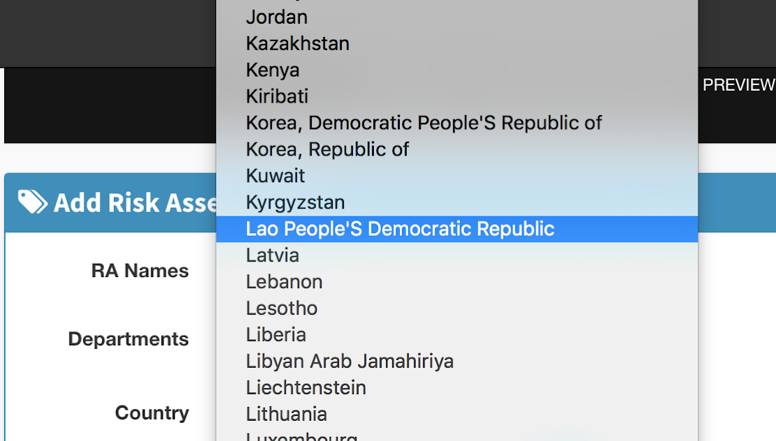
Breadcrumb 1 –
Capitalise first letters on ‘Approving Manager’.
2.) fix random capitalisation of AndorrA, RWANDA and Lao People’S Democratic Republic in country list. 3.) Rename description of task to Task Description.
4.) Capital letter on first letter of Description in Itinerary field

Slide 14
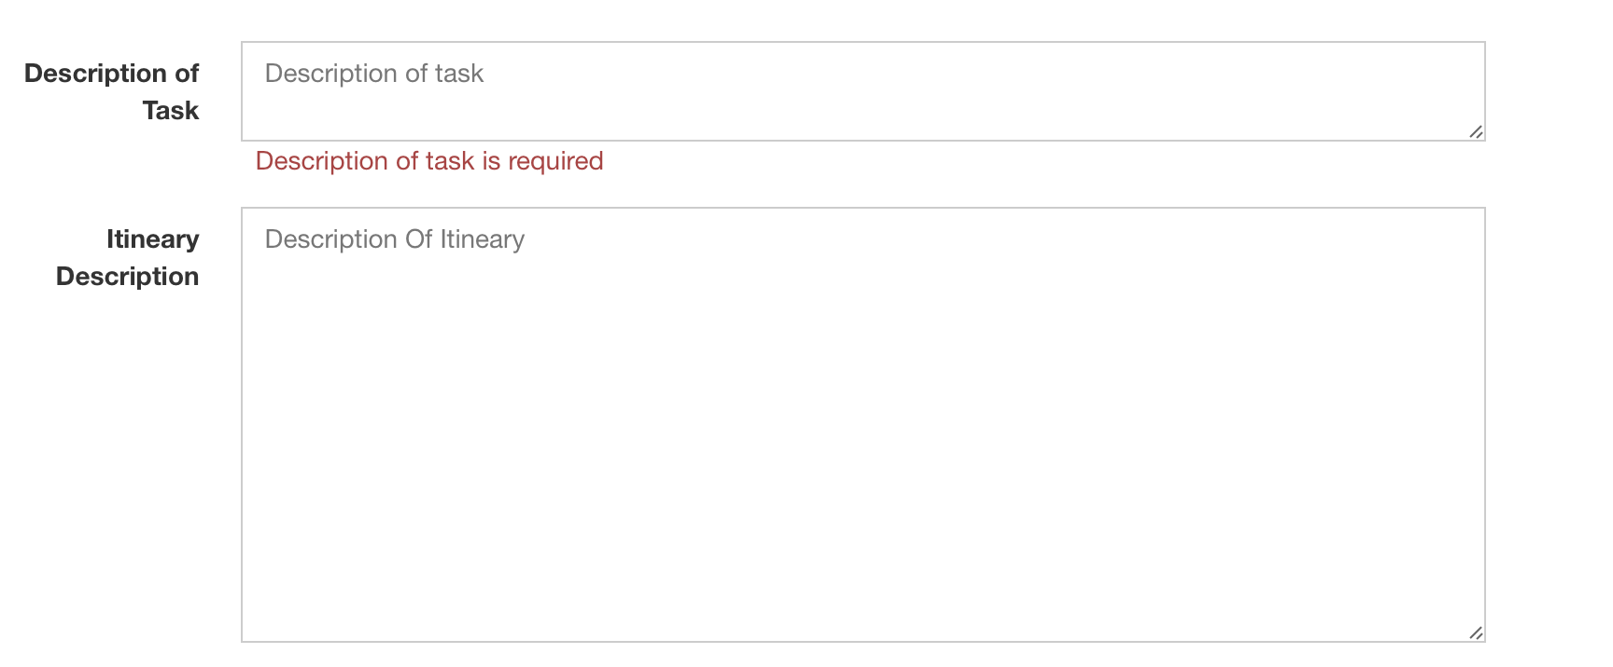
Breadcrumb 1 -
1. ) Change ghost text to Description of Itinerary

Slide 15
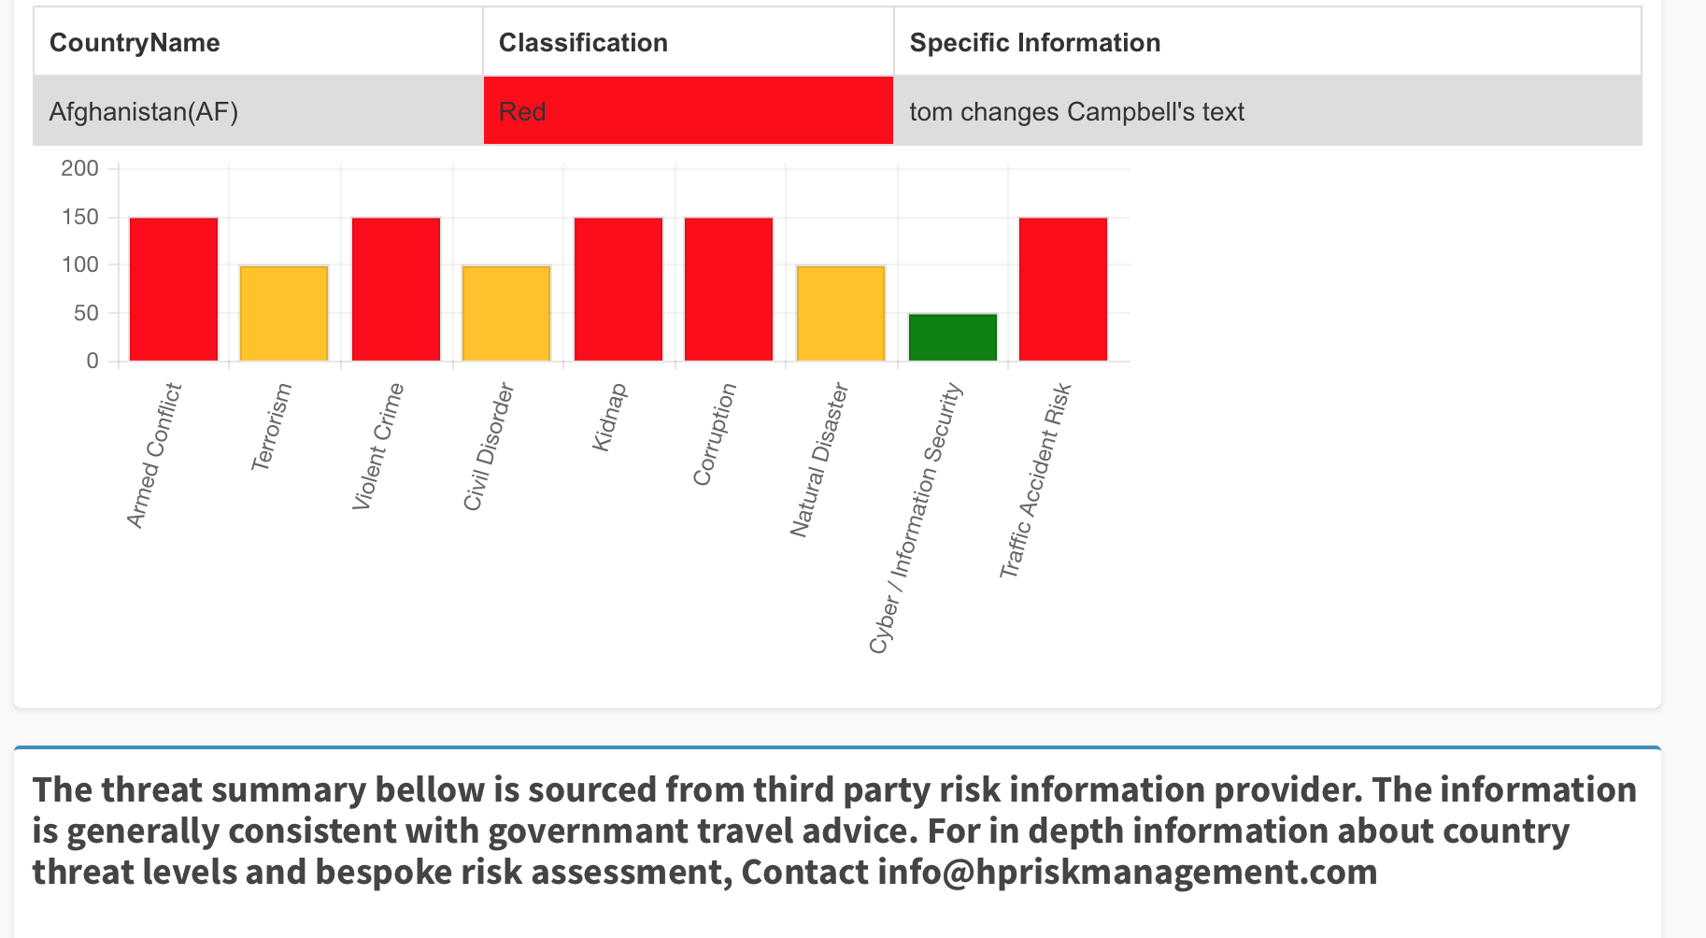
Breadcrumb 2 - 1.) Spelling errors. ‘Bellow’ and ‘governmant’. Un-capitalise ‘contact’ and change ‘in depth’ to ‘in-depth’ note, this is coded text so should be editable

Slide 16
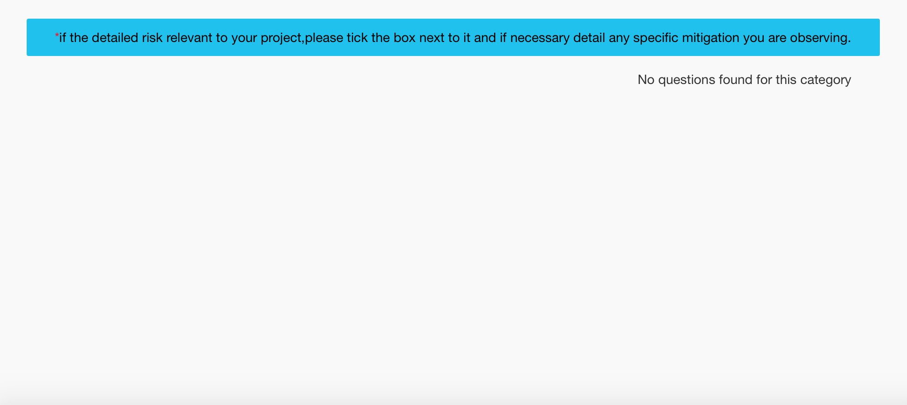
Breadcrumb 3 -
change text in box to: Please select relevant risks by using the tick box on the right side of each question. Review the advice and add additional measures that you will undertake during your trip.

Slide 17
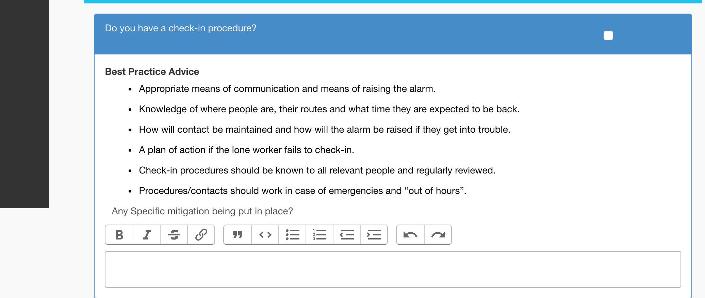
Breadcrumb 3 - 1) Add ghost text to match the text above: Additional Information / Specific Mitigation
2) Delete the formatting boxes that appear in each question

Slide 18
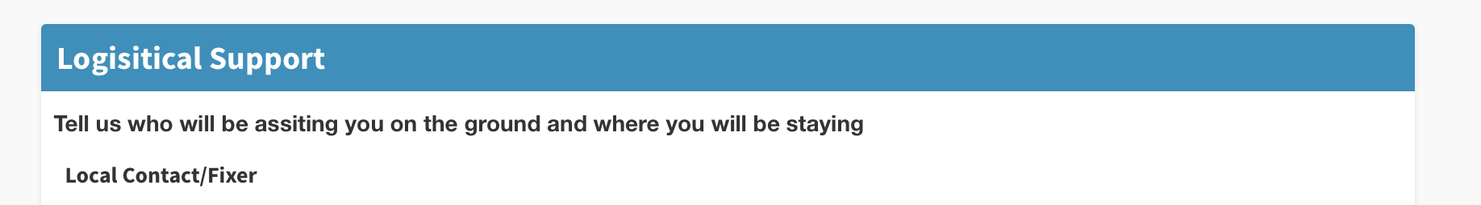
Breadcrumb 4 –
spelling error ‘assiting’. Change to assisting.

Slide 19
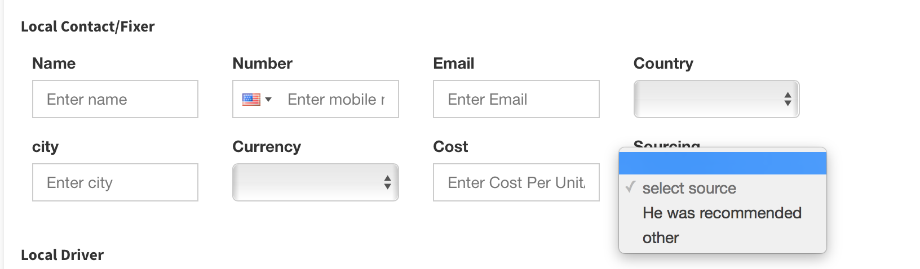
Breadcrumb 4 –
1.) change ‘He was recommended’ – to ‘Recommendation’ and capitalise ‘Other’
2.) Capital letter at start of City in field text and ghost text. Apply changes to all supplier boxes where these options appear

Slide 20
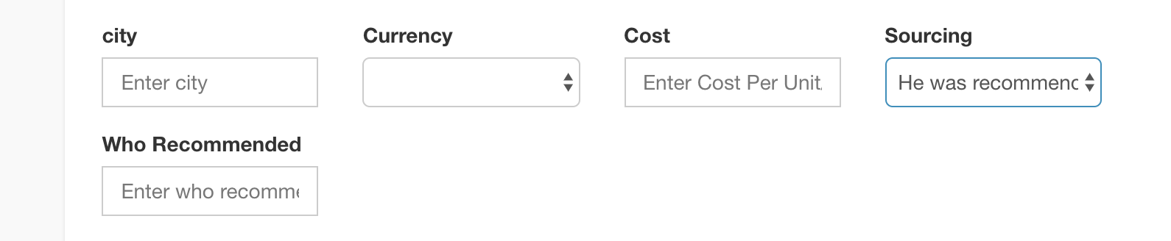
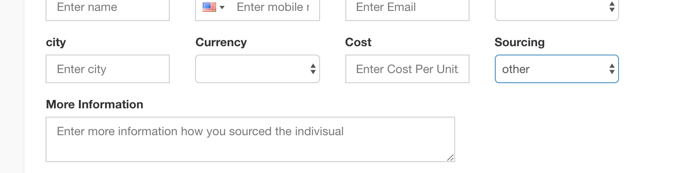
Breadcrumb 4 - 1.) when you select Recommendation (see previous slide) in Sourcing, this box appears; change text and ghost text to Recommended By.
2.) When you select Other, keep the field title as ‘More Information’ but change ghost text to ‘Provide more information about how you sourced the supplier’

Slide 21
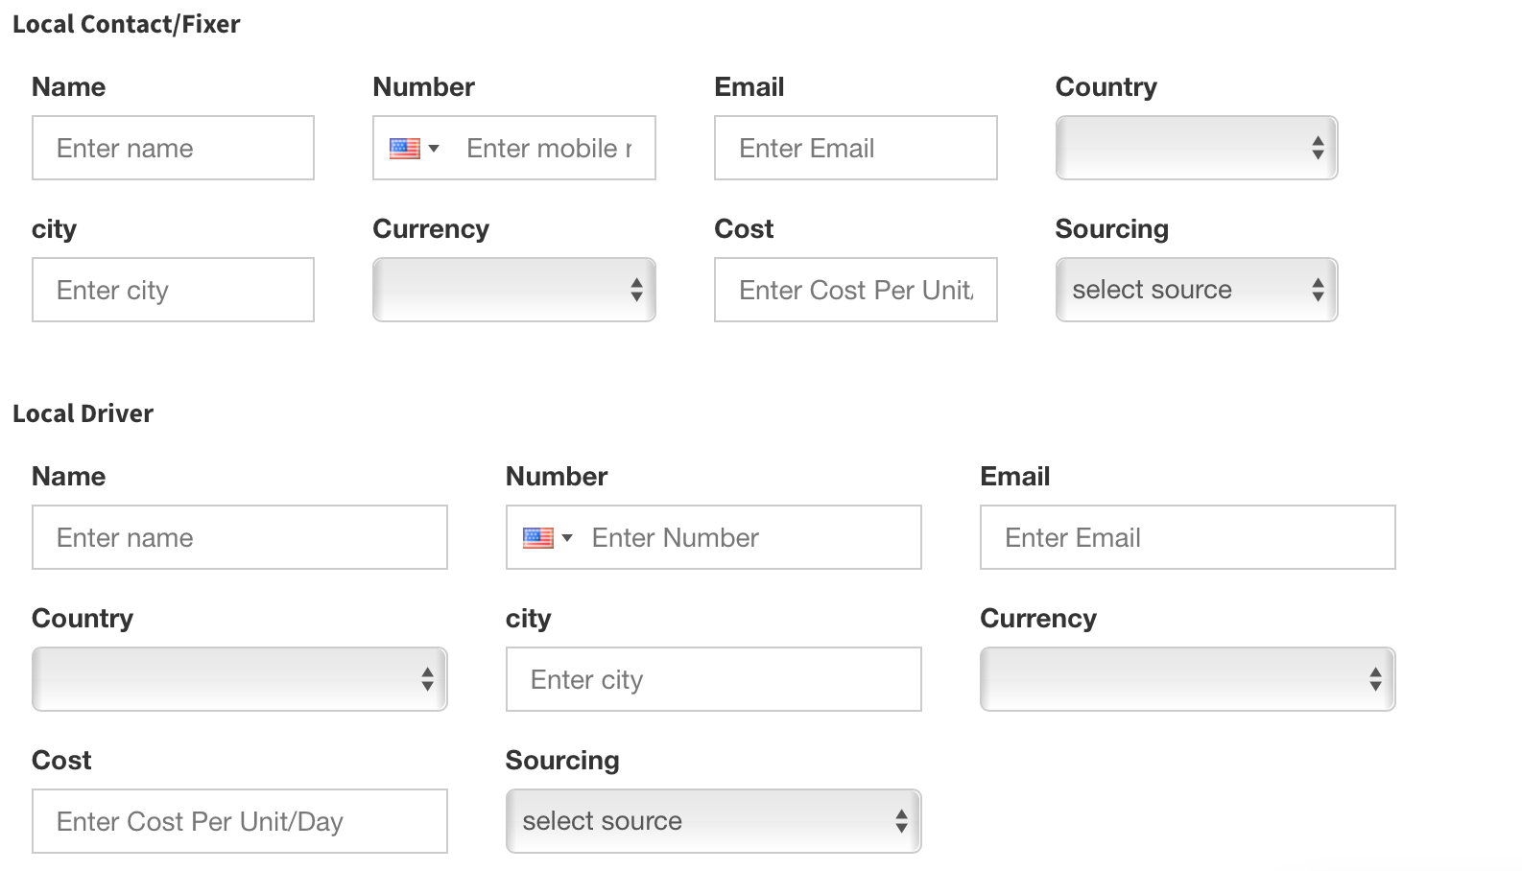
1.)Ghost text doesn’t match - remove ‘mobile’ from the first number box. Capitalise ‘Number’ on every ghost text that says Enter number
2.) Also size of boxes are different so each section looks different, e.g. four boxes on top line in first section, only three in second section - please format consistently

Slide 22
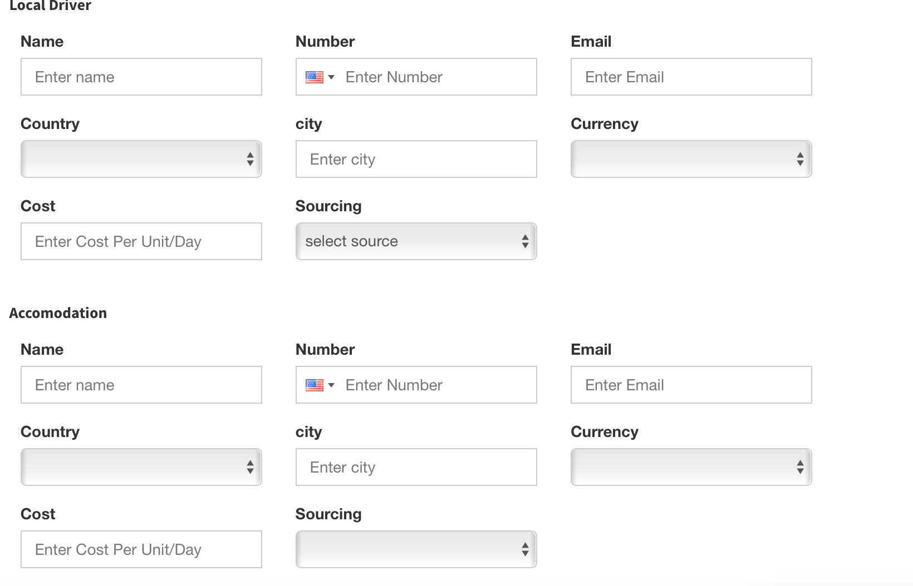
Breadcrumb 4 – 1.) Spelling error on accomodation – Change to accommodation and 2.) previously mentioned capitalisation needed. 3.) Make ghost text match on sourcing - change to Select Source
Ghost text doesn’t match

Slide 23
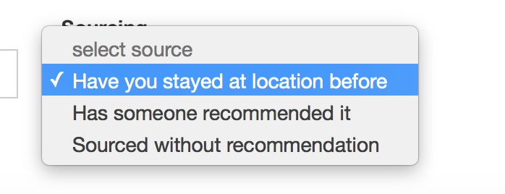
Breadcrumb 4 - 1.) Accommodation: change 3 options to Previous Stay / Recommendation / Other

Slide 24
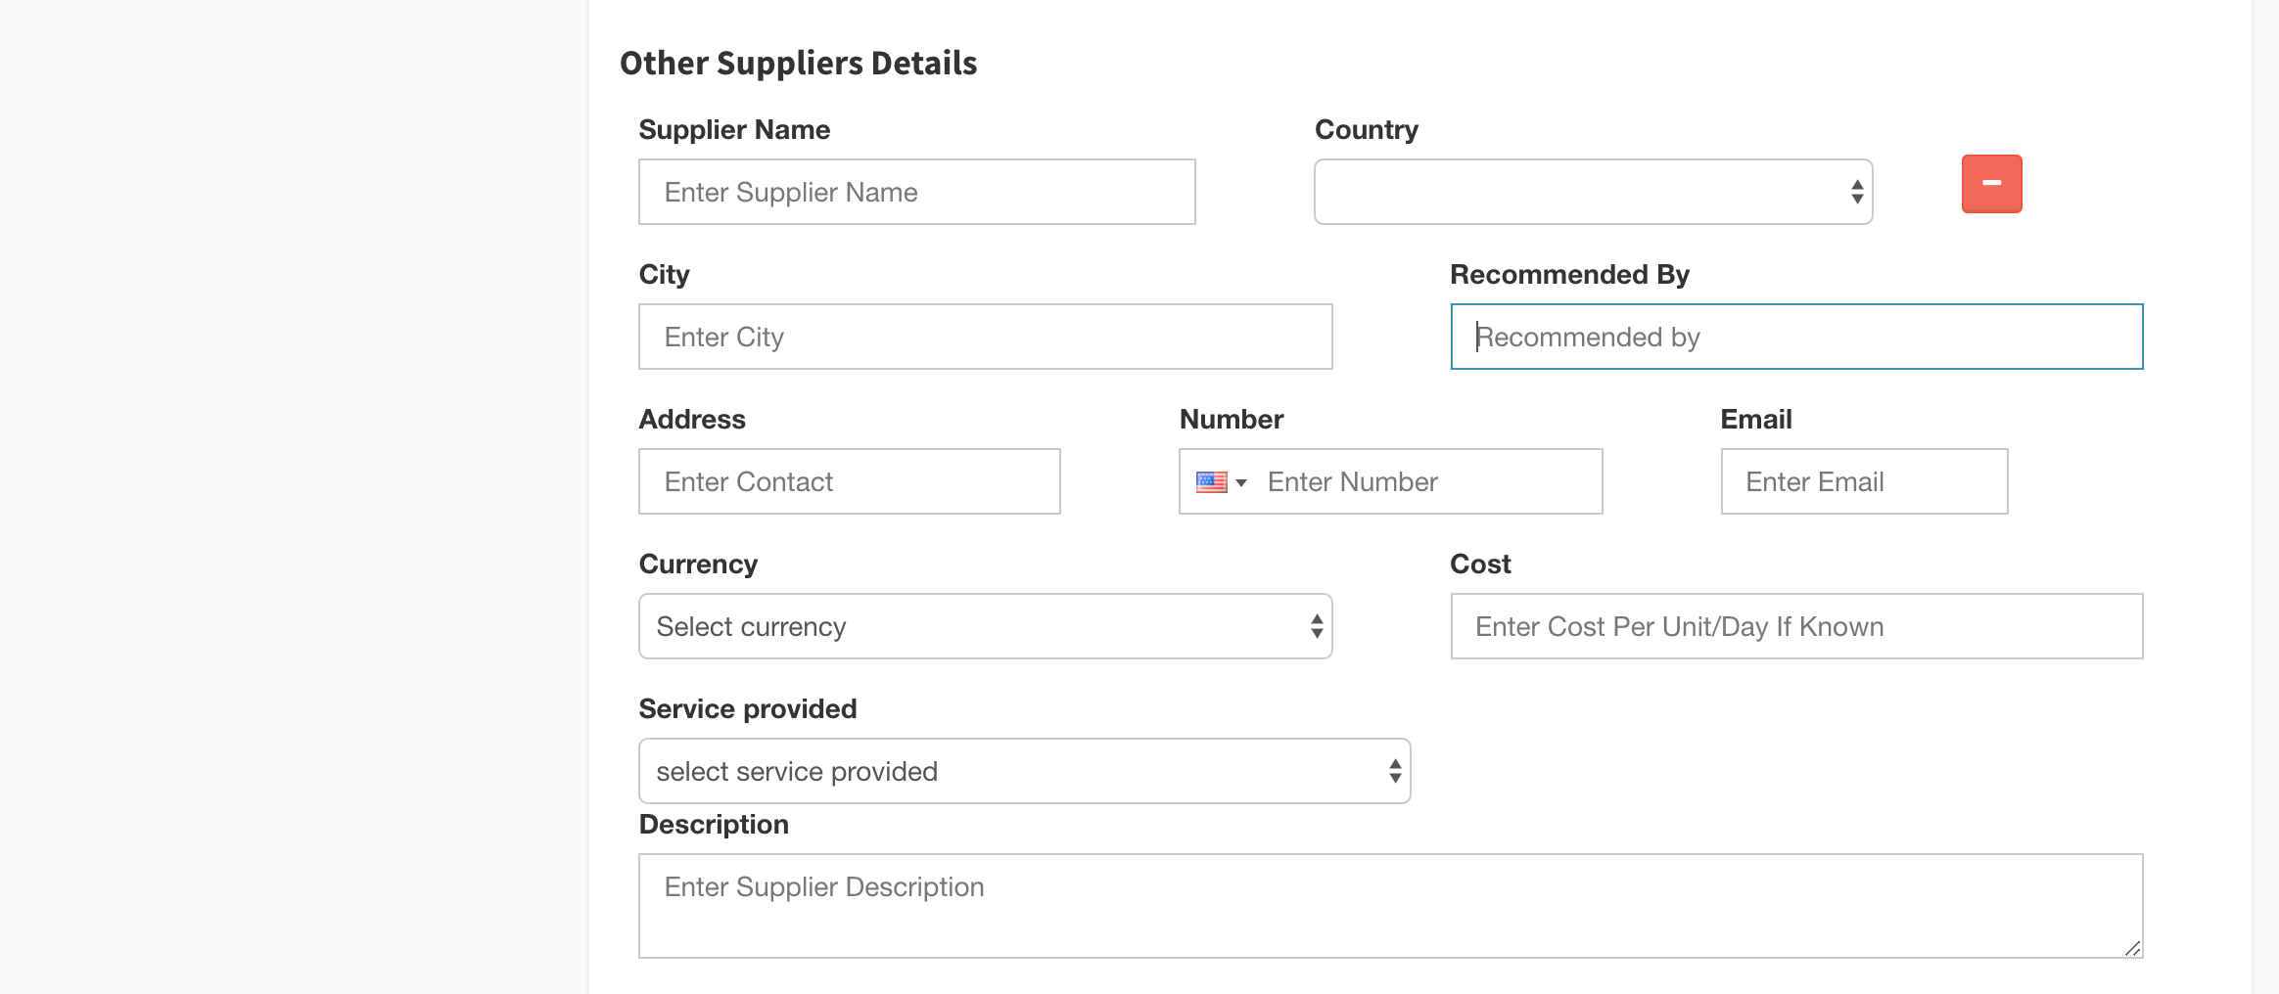
Breadcrumb 4 - change boxes in descending order:
Other Suppliers Details. - Change title to ‘Additional Suppliers’
Recommended By box should be replaced with ‘Sourcing’ and subsequent ‘Recommended By / More Information’ box should be the options, like the other suppliers
Ghost text for Cost should read ‘Cost per unit/day if known’

Slide 25
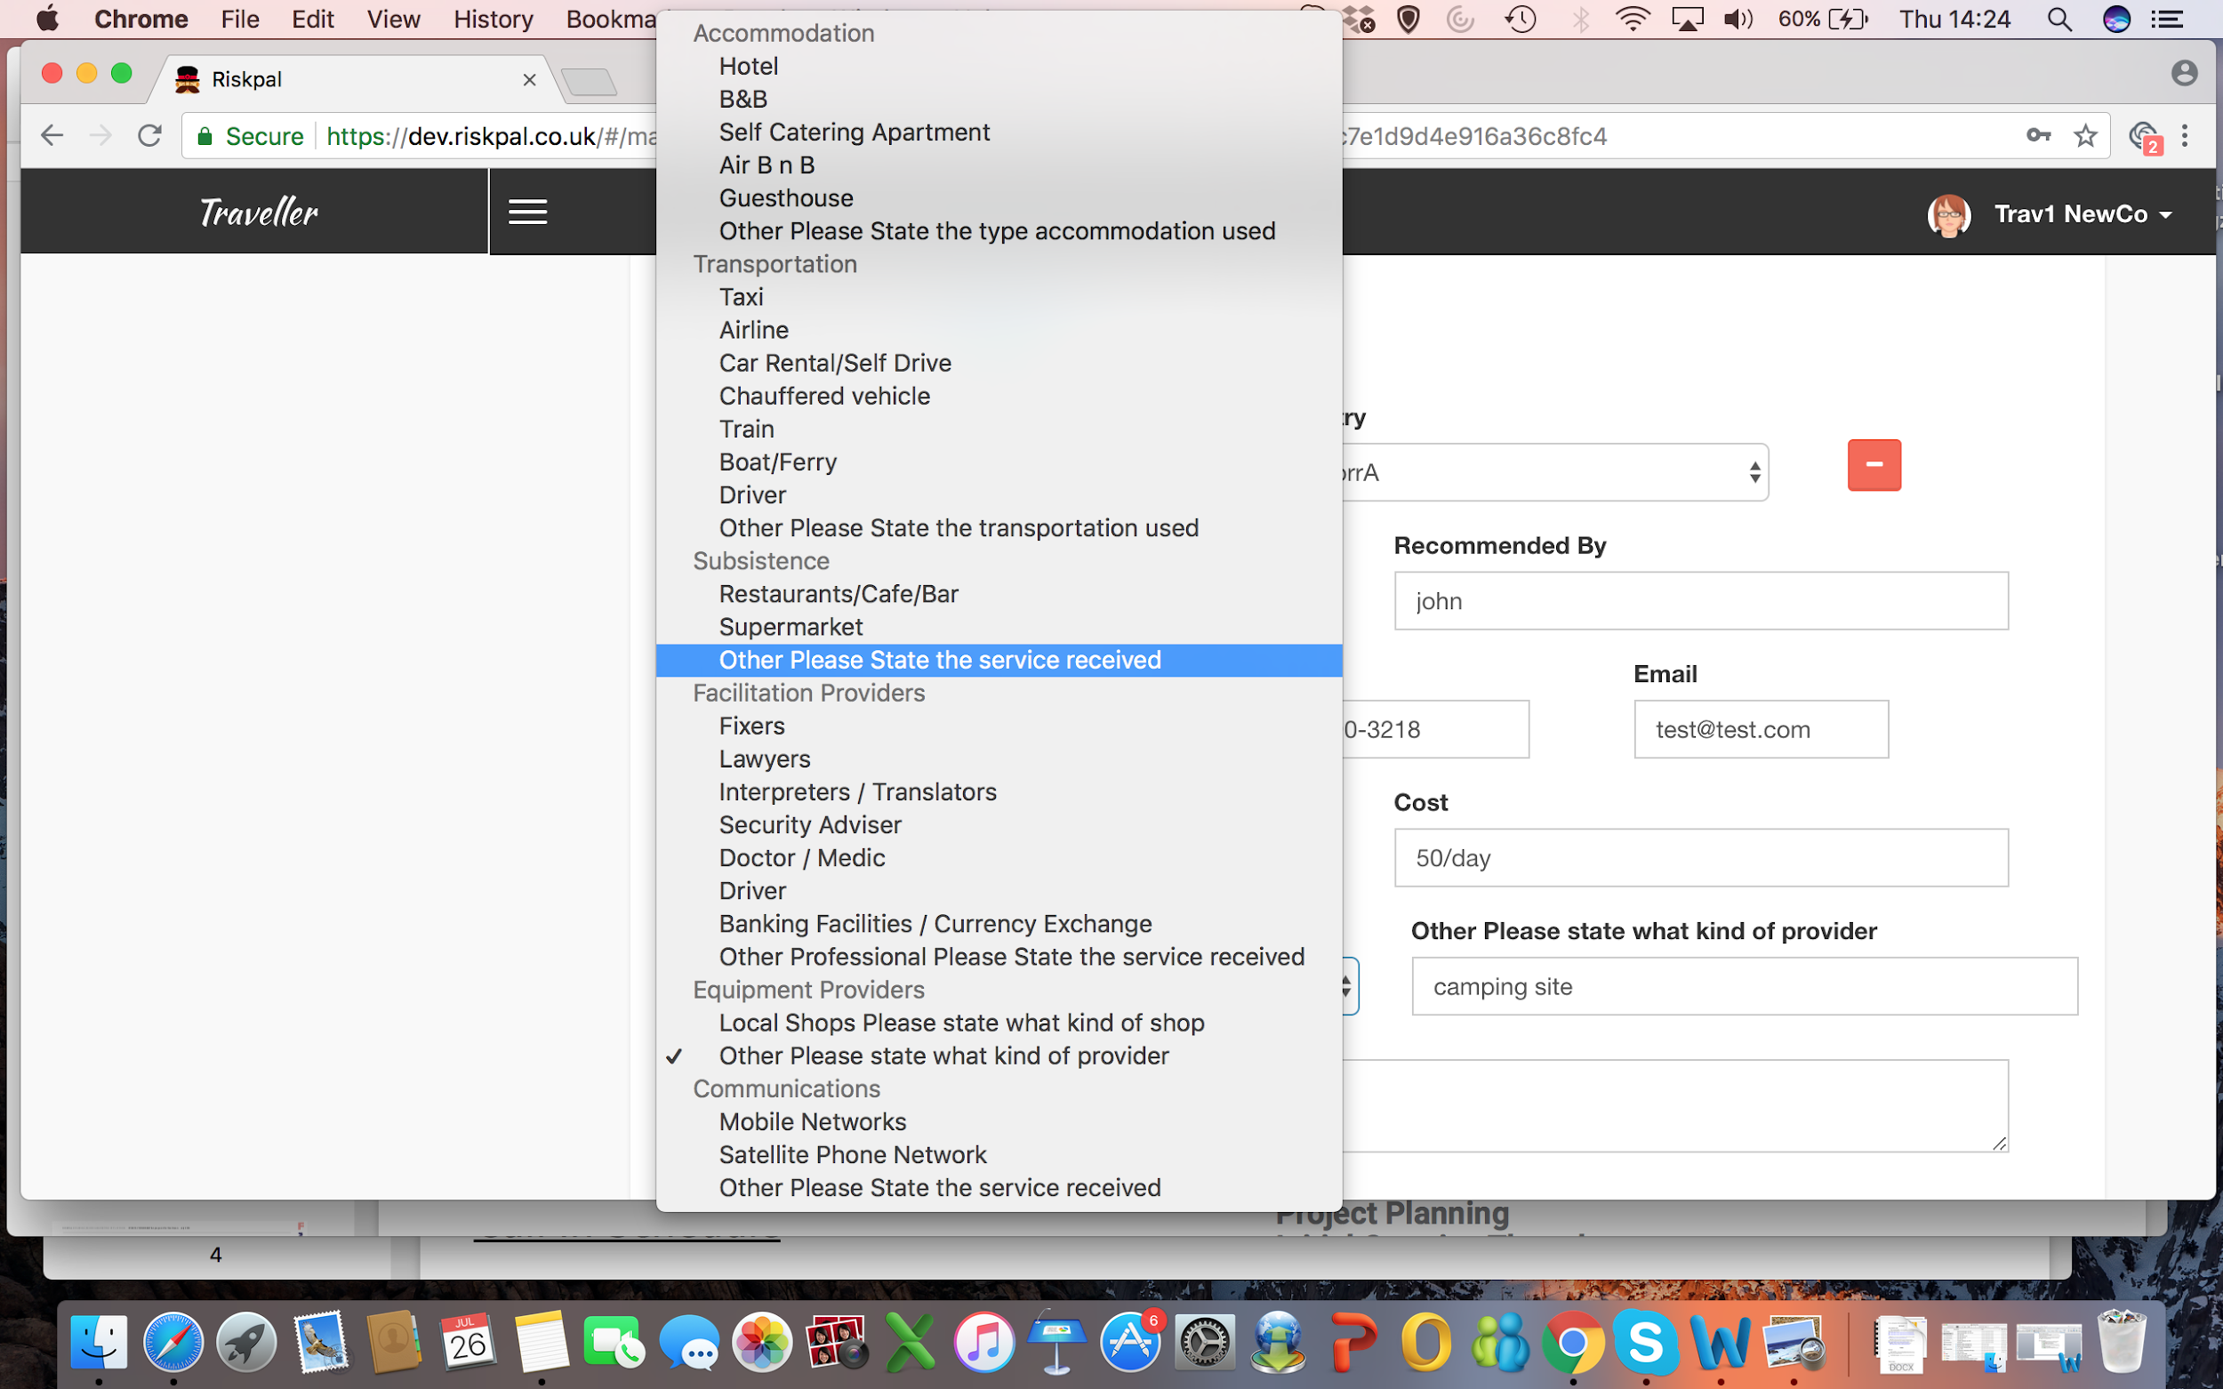
continued: Please remove the Please state… in each of the Other options highlighted here in the drop down list
Then delete Other from the sentence in each of the pop-up boxes that follows (in red)

Slide 26
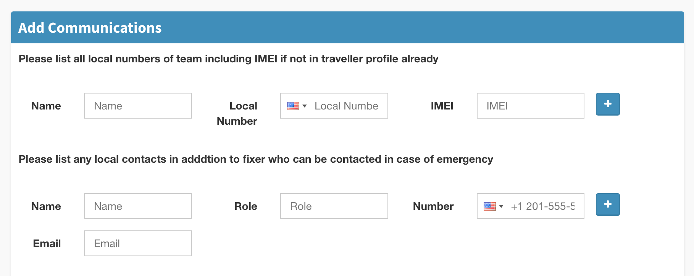
Breadcrumb 5 – 1.) number already input. Other changes already documented in template creation process

Slide 27
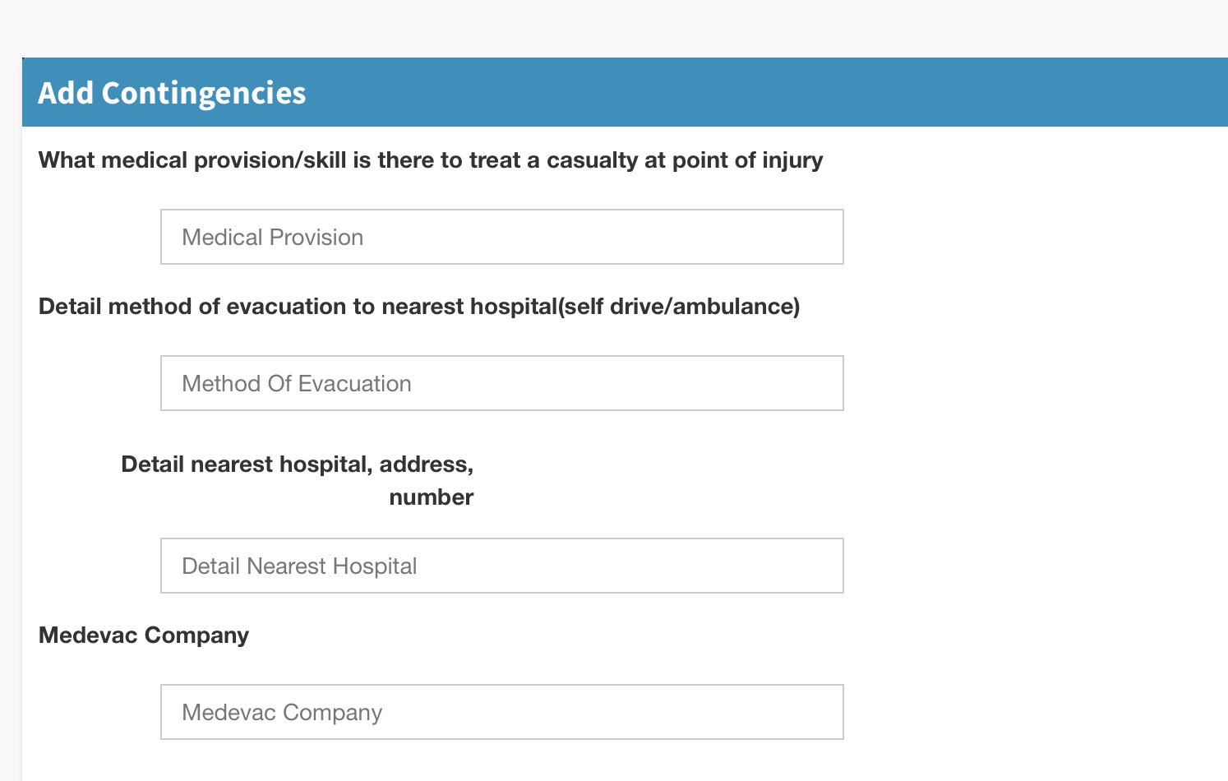
Breadcrumb 6 – 1.) weird formatting in box. have on a single line.

Slide 28
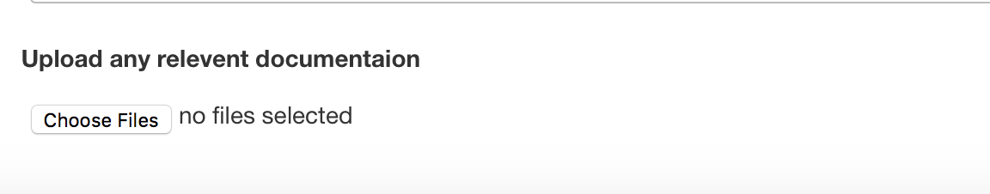
Breadcrumb 7 -
1.) change Upload any relevant documentation text to ‘Upload Supporting Information’

Slide 29
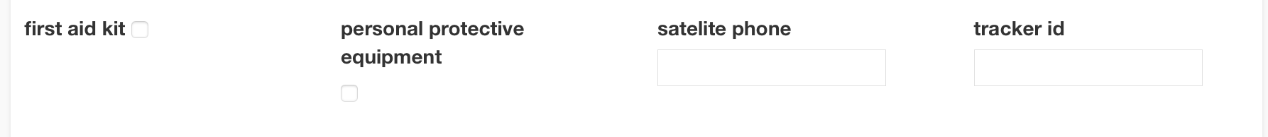
Breadcrumb 8.
Check & Submit – need to capitalise first letter on each word 2. Tracker id - Change to Tracker ID

Slide 30
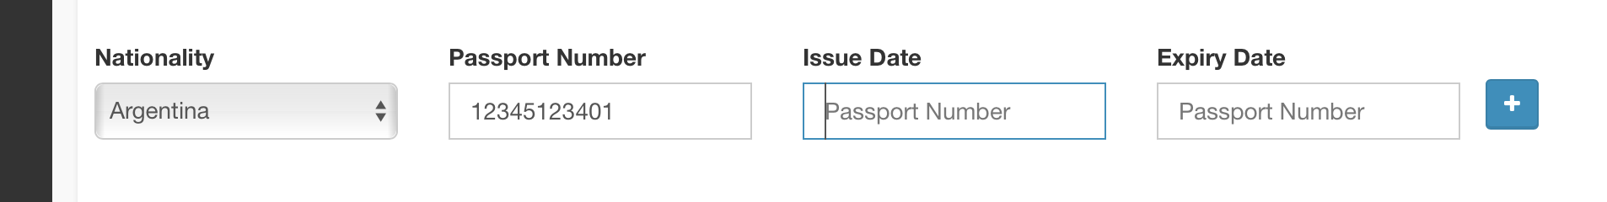
My Profile wrong ghost text fields below. they should be a calendar

